Slide 1
ALGEBRA FOR 8TH GRADERS: EVIDENCE ON ITS EFFECTS FROM 10 NORTH CAROLINA DISTRICTS Charles T. Clotfelter Helen F. Ladd Jacob L. Vigdor

Slide 3
October 2010

Slide 4
North Carolina’s 10 Largest Districts

Slide 5
Largest City, Enrollment, and EOC Passing Rates, Ten N.C. Districts
School Districts | Largest City | District Enrollment | Pass Algebra I | Pass Geometry | Pass Algebra II by 12th Grade
 |  |  | by 10th Grade | by 11th Grade
Wake | Raleigh | 141,194 | 93.1 | 84.5 | 84.0
CMS | Charlotte | 134,121 | 57.1 | 35.1 | 41.3
Guilford | Greensboro | 71,079 | 73.2 | 48.3 | 55.0
Cumberland | Fayetteville | 53,264 | 66.0 | 44.0 | 47.4
Forsyth | Winston | 51,526 | 74.9 | 57.4 | 59.8
 | Salem
Union | Monroe | 39,200 | 93.6 | 80.9 | 80.1
Johnston | Smithfield | 32,063 | 70.9 | 39.3 | 42.5
Durham | Durham | 31,867 | 56.3 | 33.5 | 46.7
Gaston | Gastonia | 32,169 | 86.4 | 60.6 | 60.7
Cabarrus | Concord | 28,127 | 97.6 | 93.1 | 90.4

Slide 6
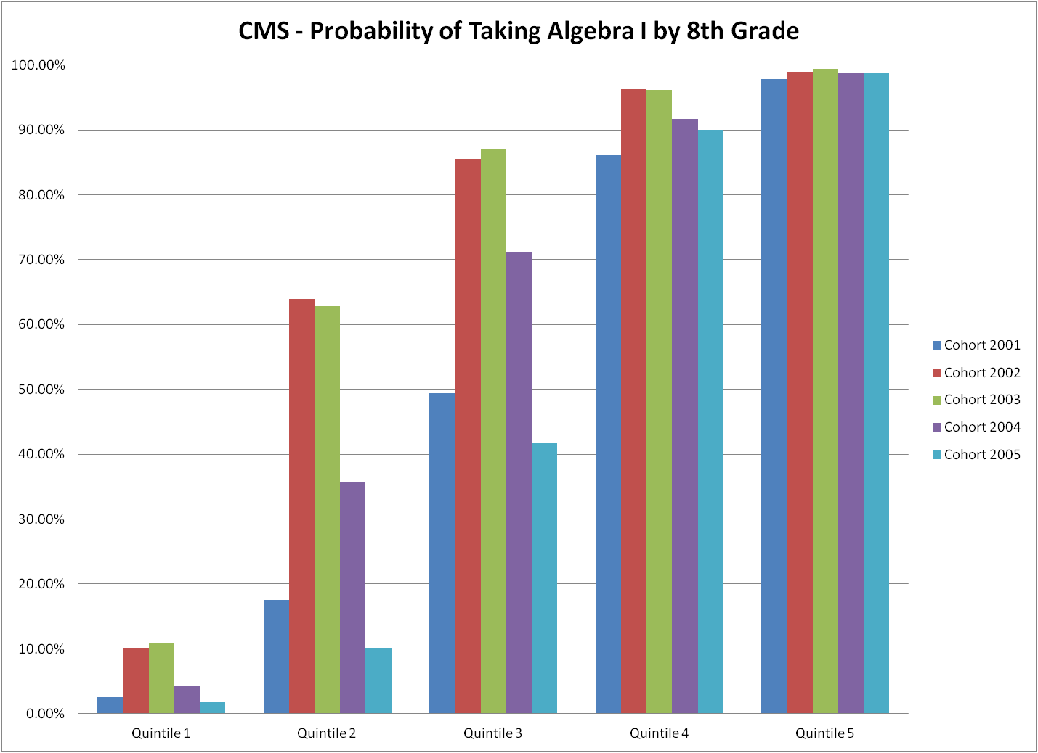

Slide 7
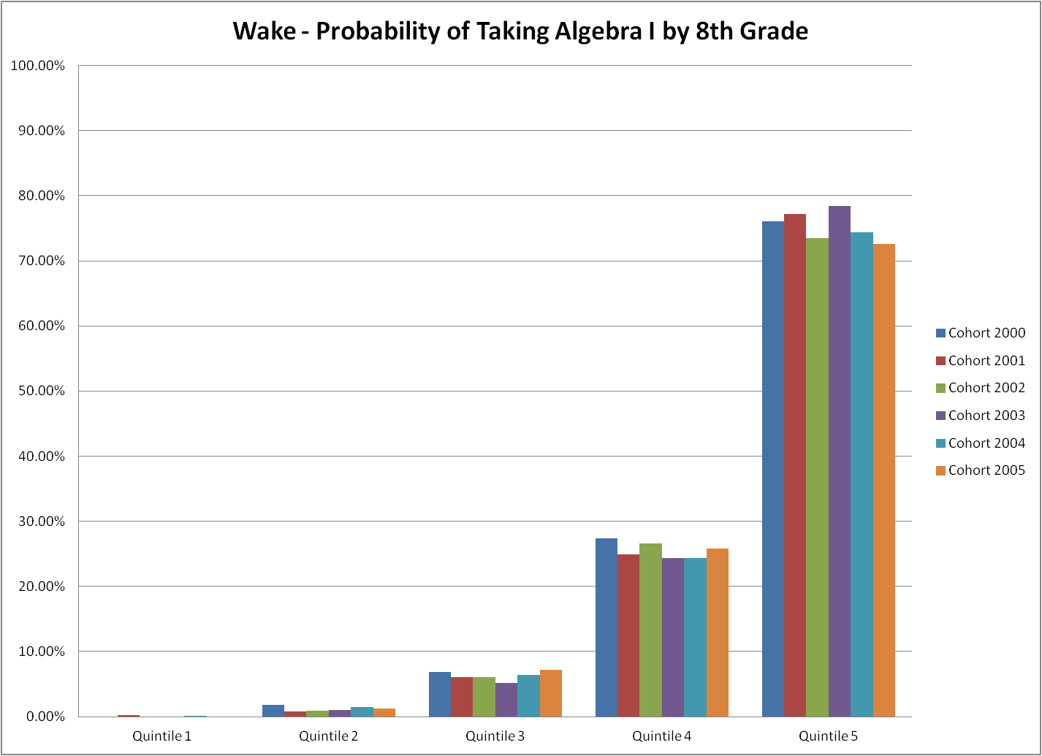

Slide 8
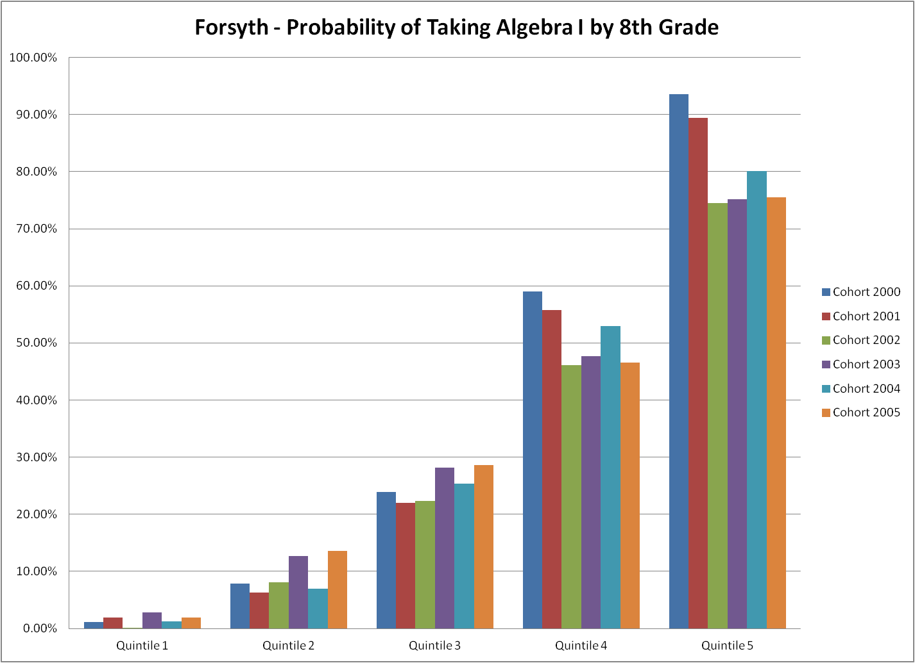

Slide 9
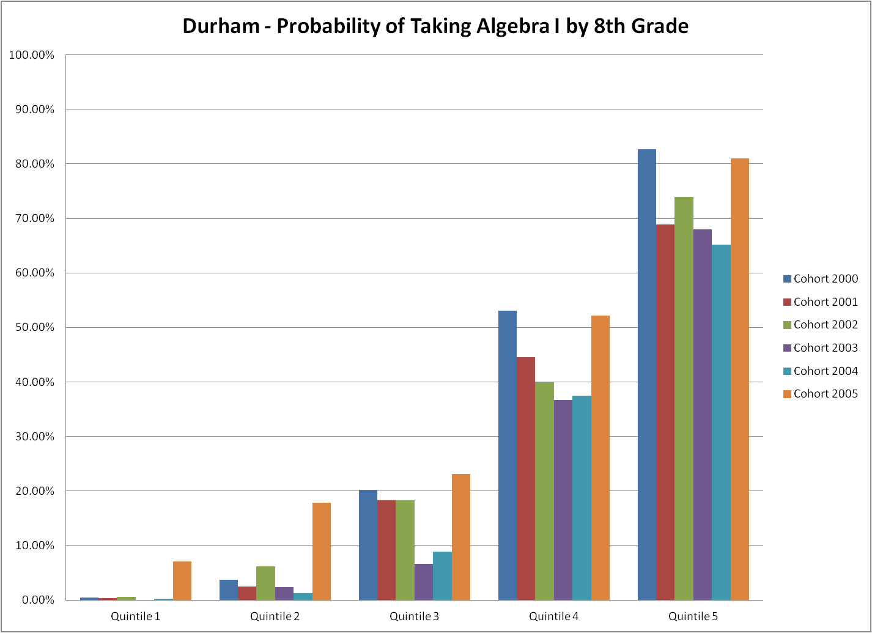

Slide 10
Chi-squared Tests for Variation in Risk for Algebra I
 | Bottom Decile | Decile 2 | Decile 3 | Decile 4 | Decile 5 | Decile 6 | Decile 7 | Decile 8 | Decile 9 | Top Decile
Wake | 0.339 | 0.547 | 0.857 | 0.154 | 0.048 | 0.141 | 0.788 | 0.044 | 0.017 | 0.000
CMS | 0.028 | 0.000 | 0.000 | 0.000 | 0.000 | 0.000 | 0.000 | 0.000 | 0.000 | 0.744
Guilford | 0.000 | 0.000 | 0.000 | 0.000 | 0.000 | 0.000 | 0.000 | 0.000 | 0.000 | 0.000
Cumberland | 0.261 | 0.000 | 0.000 | 0.000 | 0.000 | 0.000 | 0.000 | 0.001 | 0.000 | 0.000
Forsyth | 0.634 | 0.004 | 0.000 | 0.057 | 0.727 | 0.030 | 0.063 | 0.000 | 0.000 | 0.000
Union | N/A | N/A | 0.465 | 0.683 | 0.024 | 0.158 | 0.003 | 0.006 | 0.003 | 0.000
Johnston | N/A | 0.070 | 0.039 | 0.007 | 0.308 | 0.003 | 0.281 | 0.004 | 0.069 | 0.148
Durham | 0.000 | 0.000 | 0.000 | 0.000 | 0.000 | 0.000 | 0.000 | 0.019 | 0.000 | 0.000
Gaston | 0.565 | 0.664 | 0.487 | 0.045 | 0.050 | 0.025 | 0.067 | 0.249 | 0.000 | 0.002
Cabarrus | N/A | N/A | N/A | N/A | 0.640 | 0.755 | 0.424 | 0.003 | 0.000 | 0.035

Slide 11
F-tests for Unexplained Variation in Risk for Algebra I
 | Bottom Decile | Decile 2 | Decile 3 | Decile 4 | Decile 5 | Decile 6 | Decile 7 | Decile 8 | Decile 9 | Top Decile
Wake | 0.001 | 0.000 | 0.000 | 0.001 | 0.000 | 0.000 | 0.000 | 0.000 | 0.000 | 0.000
CMS | 0.000 | 0.000 | 0.001 | 0.000 | 0.000 | 0.084 | 0.078 | 0.000 | 0.000 | 0.000
Guilford | 0.000 | 0.000 | 0.000 | 0.000 | 0.000 | 0.000 | 0.000 | 0.000 | 0.000 | 0.000
Cumberland | 0.000 | 0.000 | 0.000 | 0.000 | 0.001 | 0.449 | 0.000 | 0.004 | 0.003 | 0.000
Forsyth | 0.000 | 0.000 | 0.000 | 0.000 | 0.000 | 0.000 | 0.000 | 0.000 | 0.000 | 0.000
Union | 0.314 | 0.001 | 0.000 | 0.000 | 0.000 | 0.116 | 0.000 | 0.242 | 0.000 | 0.000
Johnston | 0.000 | 0.000 | 0.001 | 0.000 | 0.000 | 0.000 | 0.000 | 0.000 | 0.000 | 0.000
Durham | 0.000 | 0.000 | 0.000 | 0.000 | 0.000 | 0.175 | 0.000 | 0.000 | 0.000 | 0.000
Gaston | 0.000 | 0.000 | 0.000 | 0.634 | 0.000 | 0.004 | 0.000 | 0.004 | 0.000 | 0.000
Cabarrus | 0.000 | 0.000 | 0.000 | 0.000 | 0.299 | 0.000 | 0.000 | 0.000 | 0.000 | 0.000

Slide 12
Decile-district Subsamples Excluded
 | Bottom Decile | Decile 2 | Decile 3 | Decile 4 | Decile 5 | Decile 6 | Decile 7 | Decile 8 | Decile 9 | Top Decile
Wake | X | X | X | X |  | X | X
CMS |  |  |  |  |  | X | X |  |  | X
Guilford
Cumberland | X |  |  |  |  | X
Forsyth | X |  |  | X | X |  | X
Union | X | X | X | X |  | X |  | X
Johnston | X | X |  |  | X |  | X |  | X | X
Durham |  |  |  |  |  | X
Gaston | X | X | X | X |  |  | X | X
Cabarrus | X | X | X | X | X | X | X

Slide 13
OLS: Coefficients on Algebra I by 8th Grade (other correlates: cohort, district, test decile)
Independent variable | Algebra I Test Scores | Pass Algebra I by 10th grade | Pass Geometry by 11th grade | Pass Algebra II by 12th grade
Enrolled in Algebra I by 8th Grade | -0.0850*** (0.021) | 0.137*** (0.012) | 0.0519*** (0.006) | 0.0866*** (0.006)

Slide 14
Instrumental Variable Estimates of the Impact of Acceleration into Algebra I in 8th Grade
 | Algebra I Test Score | Pass Algebra I by 10th grade |  | Pass Geometry by 11th grade |  | Pass Algebra II by 12th grade
Independent variable | IVQR w/imputation | 2SLS | BP | 2SLS | BP | 2SLS | BP
Enrolled in Algebra I by 8th Grade | -0.374*** | 0.091*** | 0.400*** | -0.066*** | -0.152** | -0.026* | -0.038
 | (0.006) | (0.021) | (0.086) | (0.014) | (0.056) | (0.012) | (0.046)
Adjusted R² |  | 0.484 |  | 0.564 |  | 0.436

Slide 15
Quintile Interaction Effects of the Impact of Acceleration into Algebra I in 8th Grade
Independent variable: Quintile X student * enrolled in Algebra I by 8th grade | Algebra I Test Score |  | Pass Algebra I by 10th grade | Pass Geometry by 11th grade | Pass Algebra II by 12th grade
Quintile | OLS | QR w/imputation | OLS | OLS | OLS
5 | -0.183*** | 0.028*** | 0.192*** | 0.0202* | 0.0935***
 | 0.035 | 0.002 | 0.018 | 0.009 | 0.008
4 | -0.197*** | -0.156*** | 0.140*** | 0.016 | 0.089***
 | 0.036 | 0.001 | 0.014 | 0.011 | 0.015
3 | -0.185*** | -0.160*** | 0.091*** | 0.0249 | 0.108***
 | 0.031 | 0.001 | 0.012 | 0.015 | 0.013
2 | -0.098** | -0.046*** | 0.075*** | 0.0767*** | 0.0903***
 | 0.03 | 0.001 | 0.006 | 0.007 | 0.009
1 | 0.058 | 0.136*** | 0.130*** | 0.0736*** | 0.0721***
 | 0.037 | 0.001 | 0.027 | 0.007 | 0.006
Adjusted R² | 0.721 | 0.376 | 0.425 | 0.572 | 0.443

Slide 16
Instrumented Quintile Interaction Effects of the Impact of Acceleration into Algebra I in 8th Grade
Independent variable: Quintile X student * enrolled in Algebra I by 8th grade | Algebra I Test Score |  | Pass Algebra I by 10th grade | Pass Geometry by 11th grade | Pass Algebra II by 12th grade
Quintile | 2SLS | RFQR w/imputa-tion | 2SLS | 2SLS | 2SLS
5 | -0.479*** | -0.240*** | 0.221*** | -0.108*** | -0.0627
 | 0.08 | 0.015 | 0.037 | 0.031 | 0.048
4 | -0.456*** | -0.397*** | 0.0921*** | -0.081*** | -0.0401*
 | 0.034 | 0.006 | 0.022 | 0.012 | 0.016
3 | -0.429*** | -0.398*** | 0.0356* | -0.085*** | -0.0174
 | 0.034 | 0.006 | 0.015 | 0.018 | 0.02
2 | -0.324*** | -0.260*** | 0.0462** | -0.0129 | -0.015
 | 0.048 | 0.006 | 0.014 | 0.018 | 0.017
1 | -0.306*** | -0.140*** | 0.096*** | 0.0687** | 0.011
 | 0.092 | 0.01 | 0.022 | 0.026 | 0.023
Adjusted R² | 0.712 | 0.376 | 0.424 | 0.568 | 0.436

Slide 17
Instrumented Gender Interaction Effects of the Impact of Acceleration into Algebra I in 8th Grade
Independent variable | Algebra I Test Score |  | Pass Algebra I by 10th grade | Pass Geometry by 11th grade | Pass Algebra II by 12th grade
 | 2SLS | RFQR w/imputa-tion | 2SLS | 2SLS | 2SLS
Enrolled in Algebra I by 8th Grade | -0.416*** | -0.398*** | 0.0695** | -0.0678*** | -0.0447***
 | 0.028 | 0.011 | 0.022 | 0.014 | 0.013
Male | -0.064*** | -0.118*** | -0.051*** | -0.0159*** | -0.068***
 | 0.009 | 0.005 | 0.006 | 0.004 | 0.007
Enrolled in Algebra I by 8th Grade | 0.014 | 0.070*** | 0.045*** | 0.0042 | 0.0379***
* Male | 0.021 | 0.008 | 0.007 | 0.006 | 0.011
Adjusted R² | 0.71 | 0.377 | 0.485 | 0.564 | 0.439

Slide 18
Instrumented Free/Reduced Lunch Interaction Effects of the Impact of Acceleration into Algebra I in 8th Grade
Independent variable | Algebra I Test Score |  | Pass Algebra I by 10th grade | Pass Geometry by 11th grade | Pass Algebra II by 12th grade
 | 2SLS | RFQR w/imputa-tion | 2SLS | 2SLS | 2SLS
Enrolled in Algebra I by 8th Grade | -0.330*** | -0.315*** | 0.0467* | -0.0765*** | -0.0534***
 | 0.034 | 0.012 | 0.019 | 0.018 | 0.015
On Free/Reduced Lunch | -0.0752*** | -0.141*** | -0.0835*** | -0.0831*** | -0.103***
 | 0.011 | 0.006 | 0.007 | 0.01 | 0.01
Enrolled in Algebra I by 8th Grade | -0.124*** | -0.039*** | 0.0884*** | 0.0308* | 0.0621***
* On Free/Reduced Lunch | 0.02 | 0.01 | 0.01 | 0.014 | 0.013
Adjusted R² | 0.714 | 0.378 | 0.485 | 0.567 | 0.439

Slide 19
Instrumented Parent Education Interaction Effects of the Impact of Acceleration into Algebra I in 8th Grade
Independent variable | Algebra I Test Score |  | Pass Algebra I by 10th grade | Pass Geometry by 11th grade | Pass Algebra II by 12th grade
 | 2SLS | RFQR w/imputa-tion | 2SLS | 2SLS | 2SLS
Enrolled in Algebra I by 8th Grade | -0.547*** | -0.358*** | 0.128*** | -0.0955*** | -0.0375*
 | 0.03 | 0.01 | 0.022 | 0.014 | 0.016
Parent with College Degree or More | 0.021* | 0.159*** | 0.077*** | 0.0534*** | 0.0869***
 | 0.009 | 0.004 | 0.006 | 0.008 | 0.009
Enrolled in Algebra I by 8th Grade | 0.202*** | 0.028** | -0.0512*** | 0.0456*** | 0.02
* Parent with College Degree or More | 0.024 | 0.008 | 0.01 | .012 | 0.015
Adjusted R² | 0.712 | 0.378 | 0.487 | 0.567 | 0.441

Slide 20
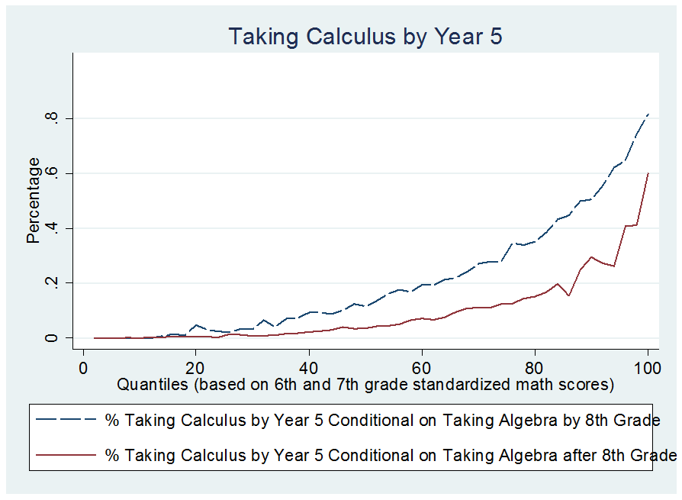
Taking Calculus: Algebra by 8th versus Algebra after 8th

Slide 21
Repeating Algebra I: Algebra by 8th , Algebra in 9th, and Algebra After 9th

