Slide 1
Late Career Teacher Retention
Dongwoo Kim
Cory Koedel
Shawn Ni
Michael Podgursky
Weiwei Wu
Department of Economics, University of Missouri
CALDER Annual Conference
Washington, DC
Feb 3, 2016
The authors wish to thank the Missouri Department of Elementary and Secondary
Education for allowing use of their teacher data, and the John and Laura Arnold
Foundation and the Center for Analysis of Longitudinal Data in Education Research (CALDER)
for research support. The usual disclaimers apply.

Slide 2
Overview
This project uses administrative data from two states to analyze effect of current and alternative pension plan designs on labor supply and workforce quality.
Findings today
STEM teachers in MO
Evaluate fit of simulations using structural estimates of teacher preferences
Simulate effect of reducing late career “push” incentives for high quality / high need teachers
Selective retention bonuses
Selective DROP plans

Slide 3
Overview
Rising Costs for Teacher Pensions
Notes:
Teachers generally, and high performing teachers in particular, seem somewhat unresponsive to price incentives. It’s difficult to get high quality teachers to move to low performing schools (Glazerman, et. al. 2012) and they are expensive to retain ( Clotfelter, et. al., 2006).

Slide 4
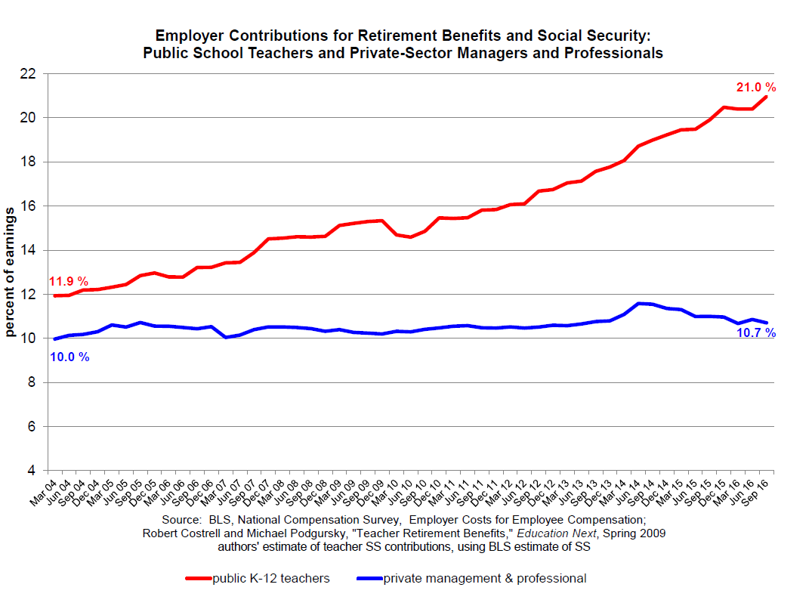
Source: Costrell. http://www.uaedreform.org/downloads/2017/01/employercontributionrates2016.pdf

Slide 5
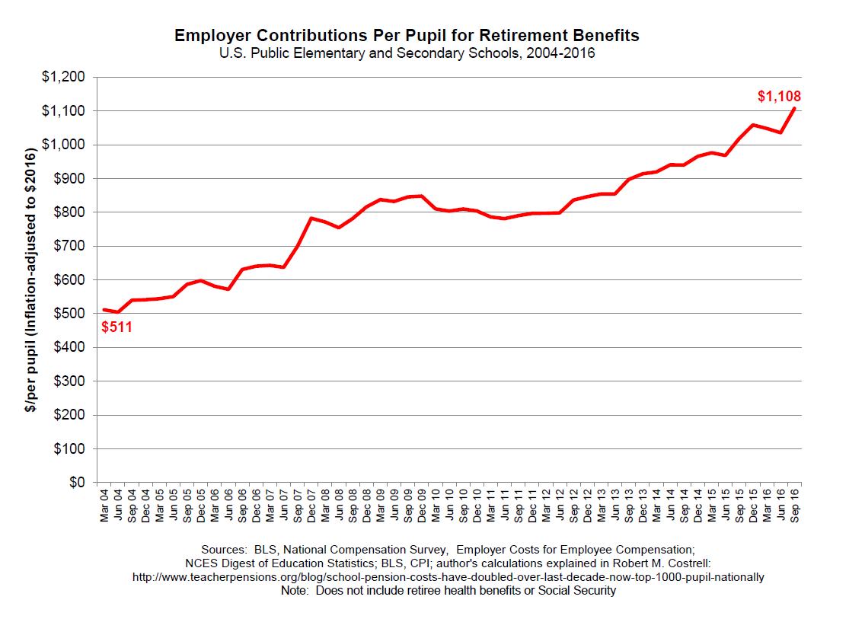
Source: Costrell. http://www.uaedreform.org/downloads/2017/01/employercontributionperpupil2016.pdf

Slide 6
Overview
Final Average Salary DB plans
Pension Plan Rules
 | MO | Tennessee
 | PSRS
Replacement Factor | 2.5 Exp ≤ 30, 2.55 Exp 31+ | 1.5
Eligibility - Regular | Age 60, Exp 30, A+E=80 | Age 62, Exp=30
Eligibility -Early | Exp 25 | Exp 25 (age penalty)
Social Security | No | Yes
Notes:
The table above presents key parameters of the Missouri and Other State DB plans. (The Other State rules are for incumbent teachers, not new hires.) An important difference is that Other State teachers are in Social Security (as teachers) and Missouri teachers are not.

Slide 7
Overview
Accrual of Pension Wealth by Age

Slide 8
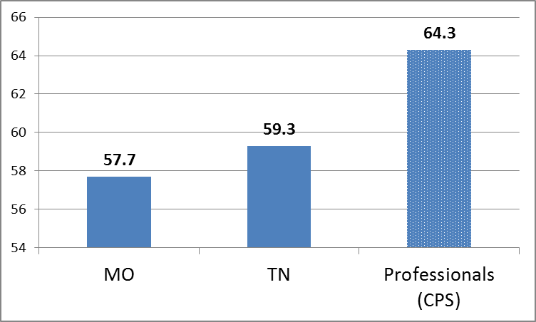
Overview
Considerable upside potential
Mean Retirement Age
Notes:
Both states are below the average for other college-educated professionals.

Slide 9
Overview
Turnover of young teachers not out of line with similar professions (Harris and Adams, 2007)
Exit of senior teachers is higher, and exit rates are responsive to pension plan incentives
Furgeson, Strauss, Vogt (2006)
Brown (2009)
Costrell & McGee (2010)
Ni and Podgursky (2016)
Knapp, et. al. (2016)
Notes:
On the other hand, a small but growing literature finds that teachers are responsive to retirement plan incentives in the timing of their retirement. Retirement rates tend to spike at predictable points (age, experience) defined by rules of the pension system – “25 and out”, “rule of 80”, age 60). When these rules change the spikes move in response.
This suggest that a more promising (and cost effective) strategy for increasing exposure of low performing students to high quality teachers is to postpone retirement for targeted groups of highly effective (or STEM) teachers.
That is, rather than entice high performing teachers to move to high need schools, entice the better teachers who are already at those schools to delay retirement.

Slide 10
Why a structural modeling approach?
Large and capricious variation in age/experience retirement incentives in current DB plans permits identification of behavioral parameters
Effects of many policy-relevant reforms will not be seen for decades
Temporary pilot programs will understate long-term effects
Cooperation of pension plan administrators is lacking
No “regulatory space” for experimentation
Exception: charter schools in some states

Slide 11
Model basics (Stock-Wise model)
In each year t, teacher chooses m (retirement year) to maximize expected utility
Future is uncertain and retirement is irreversible.
New information and circumstances arrive each year.
Continuing to work and postponing retirement leaves open the option to retire in the future
Dynamic “option value” model
Estimated on full panel of MO teachers 2001-2008
Ni and Podgursky (2016)
Structural models used to forecast MO STEM retirements 2011-2013
2131 STEM teachers aged 58-65, exp ≥ 5

Slide 12
Model Basics (Stock-Wise Model)
The period t expected utility of retiring in period m:
$$E_{t}V_{t}(m)=E_{t}\left\{\sum_{s=t}^{m−1}{β^{s−t}\left[{\left(k_{s}\left(1−c\right)Y_{s}\right)}^{γ}+ω_{s}\right]}+\sum_{s=m}^{T}{β^{s−t}\left[{\left(B_{s}\right)}^{γ}+ξ_{s} \right]}\right\}$$
denote:$v_{s}=ω_{s}−ξ_{s}$ and $ε_{s}=ε_{ωs}−ε_{ξs};$assume: $v_{s}={ρv}_{s−1}+ε_{s};$
$$β=0.965$$
$$γ=0.716$$
$$ρ=0.643$$
$$κ=0.640$$
$κ_{1}=0.976$,
$${k_{s}\text{=}κ\text{(60/}\text{age}\text{)}}^{κ_{1}}$$
$$σ=5000.0$$
Estimated on sample of MO teachers
2002-2007
For details see
Ni and Podgursky (2015)
Notes:
The parameter estimates are obtained using PSRS data for 2002-2007 (Ni and Podgursky, 2015) with a more precise measure of retirement status. The simulations reported below are out of sample in two ways: For PSRS it’s a different group of teachers in 2008-2011. For Other State it’s both a different group of teachers in a different time period, and a different set of pension rules. The sigma parameter reflects the unobserved preference shock proportional to salary and is scaled up from the PSRS 2002-2007 estimate (sigma=3660 there) to reflect an increase in salary and measurement error. Beta is the subjective discount rate, gamma captures risk-aversion and intertemporal substitution, kappa is the disutility of working.

Slide 13
Missouri STEM
Employment Survival Function
Notes:
Confidence bands commonly seen in other studies concern the standard errors of the estimator. The band in the plot assume no errors in parameters and only pertains to sampling errors stem from the draws of preference errors for each teacher. We assume aggregation of the retirement decision for each draw of the preference error for each teacher yields a survival rate. Accounting for standard errors in the parameter should make the band much wider.

Slide 14
Missouri STEM
Age Distribution Retirees

Slide 15
Missouri STEM
Age Distribution Non-Retirees

Slide 16
Policy Simulation
DB plans have powerful “pull” “push” incentives
Relax the “push” incentives for selected high value teachers

Slide 17
Policy Simulation
Simulate effect of selective retention bonuses
$5000 and $10,000 one year bonuses to senior STEM teachers in “retirement windows”
Deferred Retirement Option Plan (DROP) for STEM teachers
Notes:
There have been numerous studies simulating the effect of DC or CB-type plan versus traditional teacher plans. All find that conventional DB plans shorten work careers.
Friedberg and Web (2005), Costrell and McGee (2010), Ni and Podgursky (2016).

Slide 18
Policy Simulation
Effect of Various Retention Bonuses for Missouri STEM Teachers After Five and Ten Years
 |  | Exp=32
 |  | Targeted |  | Untargeted
 |  | Size of Bonus |  | Size of Bonus
Program Duration |  | $5,000 | $10,000 | $5,000 | $10,000
Five Years
Additional Teaching Yrs |  | 22.85 | 52.83 | 22.85 | 52.83
Gross Cost/Year |  | $83,868 | $82,274 | $837,084 | $788,765
Net Cost/Year |  | $44,709 | $43,115 | $797,925 | $749,606
Elasticity |  | 1.57 | 1.60 | 0.14 | 0.15
Ten Years
Additional Teaching Yrs |  | 60.41 | 137.90 | 60.41 | 137.90
Gross Cost/Year |  | $79,768 | $78,384 | $699,873 | $670,787
Net Cost/Year |  | $28,942 | $27,559 | $649,048 | $619,961
Elasticity |  | 1.79 | 1.82 | 0.16 | 0.16
Notes:
gross cost=the increase in the cost of the senior teachers for extra years of teaching.
net cost= gross cost-cost associated with needing fewer novice replacements.

Slide 19
Policy Simulation
Effect of Various Retention Bonuses for Missouri STEM Teachers After Five and Ten Years
 |  | Exp=32
 |  | Targeted |  | Untargeted
 |  | Size of Bonus |  | Size of Bonus
Program Duration |  | $5,000 | $10,000 | $5,000 | $10,000
Five Years
Additional Teaching Yrs |  | 22.85 | 52.83 | 22.85 | 52.83
Gross Cost/Year |  | $83,868 | $82,274 | $837,084 | $788,765
Net Cost/Year |  | $44,709 | $43,115 | $797,925 | $749,606
Elasticity |  | 1.57 | 1.60 | 0.14 | 0.15
Ten Years
Additional Teaching Yrs |  | 60.41 | 137.90 | 60.41 | 137.90
Gross Cost/Year |  | $79,768 | $78,384 | $699,873 | $670,787
Net Cost/Year |  | $28,942 | $27,559 | $649,048 | $619,961
Elasticity |  | 1.79 | 1.82 | 0.16 | 0.16
Notes:
2011 cohort. Aged 48-65, 5 or more years of experience. N=2131

Slide 20
Policy Simulation
Effect of Various Retention Bonuses for Missouri STEM Teachers After Five and Ten Years
 |  | Exp=32
 |  | Targeted |  | Untargeted
 |  | Size of Bonus |  | Size of Bonus
Program Duration |  | $5,000 | $10,000 | $5,000 | $10,000
Five Years
Additional Teaching Yrs |  | 22.85 | 52.83 | 22.85 | 52.83
Gross Cost/Year |  | $83,868 | $82,274 | $837,084 | $788,765
Net Cost/Year |  | $44,709 | $43,115 | $797,925 | $749,606
Elasticity |  | 1.57 | 1.60 | 0.14 | 0.15
Ten Years
Additional Teaching Yrs |  | 60.41 | 137.90 | 60.41 | 137.90
Gross Cost/Year |  | $79,768 | $78,384 | $699,873 | $670,787
Net Cost/Year |  | $28,942 | $27,559 | $649,048 | $619,961
Elasticity |  | 1.79 | 1.82 | 0.16 | 0.16

Slide 21
Policy Simulation
DROP Plans
Retire and Keep Working, collect some or all of pension
No further accrual of service years
Examples
Arkansas Teachers
Up to 10 years, roughly 70% of retirement annuity
Florida Teachers
Up to 4 years, full annuity

Slide 22
Policy Simulation
DROP Plan for STEM teachers
2 years
.4 or .7 of regular annuity
No further accrual of service years
Results
Very promising

Slide 23
Conclusion
Late career retention policies hold promise as a way to raise teaching workforce quality
Retention bonuses / Selective DROP plans
Targeted to high-need fields/schools/high quality teachers
Structural modeling is a useful and practical tool in analyzing pension plan reform

