Slide 1


The Effects of Differential Pay on Teacher Recruitment, Retention and Quality
Carycruz Bueno
Dept. of Economics
Georgia State University
Tim Sass
Dept. of Economics
Georgia State University
2017 CALDER Research Conference
February 3, 2017

Slide 2

Disclaimer
The contents of this report were developed using data provided by Georgia’s Academic and Workforce Analysis and Research Data System (GA•AWARDS). However, those contents do not necessarily represent the policy of GA•AWARDS or any of its participating organizations, and you should not assume endorsement by GA•AWARDS or any of its participating organizations.

Slide 3
Motivation
Concerns Over Supply of Workers in STEM Fields
  Recent evidence suggests that identity and qualifications of middle and high school math and science teachers may influence post-secondary choices over course taking and majors
    Bottia, et al. (2015); Sass (2015)
Persistent Shortages of Teachers in Fields with High Alternative Wages and/or High Training Requirements
  Math, Science and Special Education

Slide 4
Policy Responses
Provide One-Time Hiring Bonuses
  Used at varying times by California, Mississippi and Virginia
Subsidize Education of Teachers
  State Programs
    At least 40 states offer loan forgiveness, tuition reimbursement or scholarships for teachers in high-need areas
  Federal Programs
    Perkins Loan Cancellation Program for teachers cancels a portion of loan for each year teaching in a low-income school or in a high-need subject area, with complete cancellation after five years

Slide 5
Policy Responses
Offer Differential Pay
  Several district-level salary differential programs
    Examples: Aldine, TX; Hamilton County, TN; Mobile, AL
  Statewide programs
    North Carolina bonus program for math, science and special ed. teachers in high-poverty schools
      Only operated from 2001/02 – 2003/04
    Georgia provides salary supplements to math and science teachers in their first five years of teaching
      Subject of this study

Slide 6
Prior Research
Loan Forgiveness
  Feng and Sass (2015) find loan forgiveness program in Florida significantly reduced attrition among teachers in high-need areas including math, science, special ed., foreign languages and ESOL, though effects in special ed. varied with generosity of payments
  Some evidence of effectiveness in inducing lawyers to practice public interest law (Field, 2009)
Pay Differentials
  Clotfelter, et al (2008) find $1800 bonus to math, science and special ed. teachers in high poverty schools reduced turnover rates by 18%

Slide 7
Georgia’s Differential Pay System
Georgia Legislature Passed House Bill 280 in 2009
  Became Effective in 2010/11 School Year
  K-5 teachers with an endorsement in math or science receive $1000 per year up to five years
  New 6-12 teachers math and science teachers paid wages equivalent to a teacher with six years of experience
    “a secondary school teacher … who is or becomes certified in mathematics or science shall be moved to the salary step on the state salary schedule that is applicable to six years of creditable service, unless he or she is already on or above such salary step. From such salary step, the teacher shall be attributed one additional year of creditable service on the salary schedule each year for five years.”

Slide 8
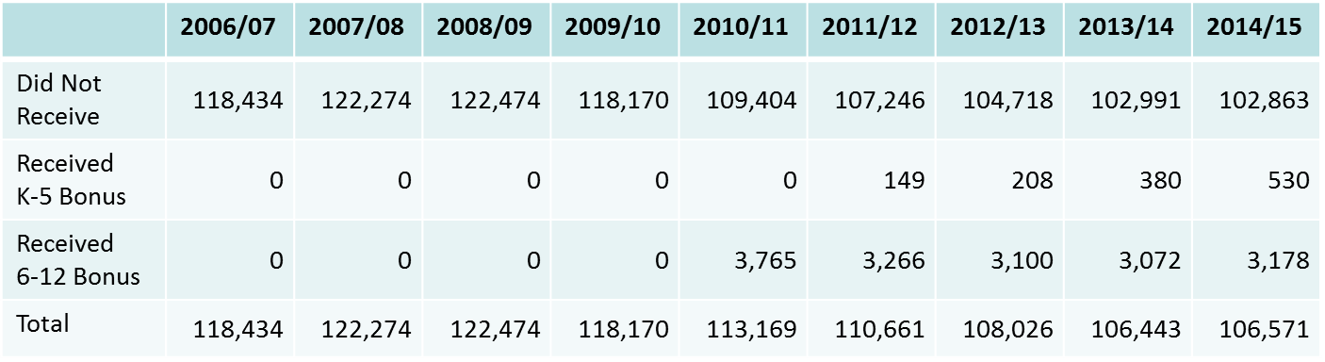
Number of Teachers
Receiving Differential Pay by Year

Slide 9
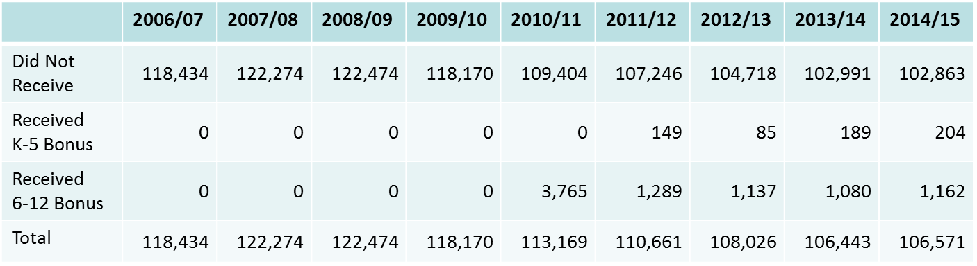
Number of Teachers Receiving
Differential Pay for the First Time by Year

Slide 10
Georgia’s Differential Pay System
Implementation of HB280 Middle/HS supplement
  The Georgia Department of Education (GaDOE) compiles a list of fully certified teachers teaching middle/high school math and science in October
  List sent to legislature who then make appropriations during the following Spring legislative session
  Funds received by GaDOE in July and then dispersed to districts
  Teachers receive checks in late August/early September (school year after being identified as eligible)

Slide 11
Georgia’s Differential Pay System
Implementation of HB280 Middle/HS Supplement
  Payment not contingent on remaining a teacher
  Amount of payment independent of actual salary
    Some district salary schedules are significantly above the state salary schedule
  Payment amount declines with experience
    Statute says “teacher … shall be moved to the salary step on the state salary schedule that is applicable to six years of creditable service … From such salary step, the teacher shall be attributed one additional year of creditable service on the salary schedule each year for five years.”
    In practice, payment equaled difference between actual step on state salary schedule and salary for teacher with 6 years of service

Slide 12
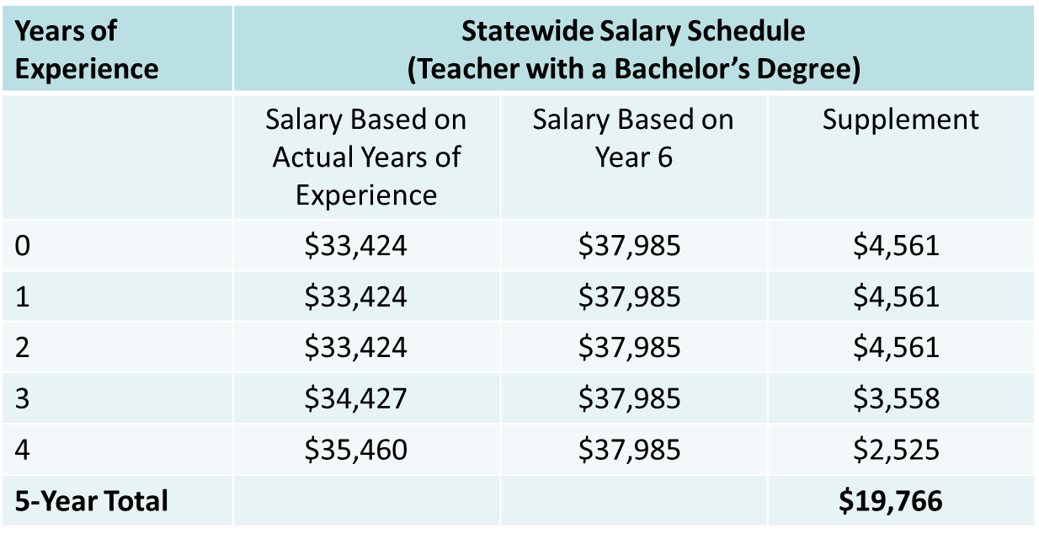
Georgia’s Differential Pay System

Slide 13
Research Questions
Has differentiated pay induced more individuals into teaching secondary math and science?
  Number of students graduating with secondary math and science education majors
  Number of first-year teachers certified to teach secondary math and science
Has differentiated pay changed the quality of secondary math and science teachers?
  Academic qualifications (GPA, SAT scores)
  Effectiveness (value added)
Has differentiated pay increased the retention rate of secondary math and science teachers?

Slide 14
Data
First Use of Georgia’s Statewide Longitudinal Data System (GA•AWARDS) by External Researchers
  Database currently covers 2006/07 through 2014/15
  K-12 teacher-level data
    demographics, certification, subject area taught
  K-12 student data
    Demographics, test scores, attendance, discipline, diploma receipt
  K-12 student-teacher links
    For Race-to-the-Top districts beginning in 2013/14
    For all districts beginning in 2015/16
  Higher education data
    Including coursework, major and SAT scores for students who later became teachers
  Database also includes pre-K and workforce data (UI records)

Slide 15
Identification Strategy
Sources of Variation
  Certification and Subject Area of Teachers
    To be eligible, must have been certified in and teaching math or certified and teaching science
    Supplement only applied to math and science teachers in grades 6-12
      Elementary math and science teachers eligible for a $1,000 annual stipend for up to 5 years
  Experience of Teachers
    To qualify, must have less than six years of experience
  Timing of Program and Duration of Benefits
    First implemented in 2010/11
  Size of benefits
    Amount varies non-linearly with experience

Slide 16
Identification Strategy
Methods
  Difference in Differences
    Can exploit differences in eligibility for supplement and differences over time in availability of program to estimate impact of program on teacher retention
  Triple Difference
    Can exploit multiple eligibility criteria to produce DDD estimate of teacher retention
      Certification x Less than 6 years of experience x Program in place

Slide 17
Descriptive Evidence
Mean Teacher Attrition Rate by Year for Math and Science Teachers in Grades 6-12 versus All Teachers
Survival Function Graphs by Supplement Receipt for Math and Science Teachers in Grades 6-12
  Full sample
  Teachers entering in 2011/12 or later

Slide 18
Percentage of Teachers
Leaving Georgia Public Schools by Year
(Teachers with 5 or Less Years of Experience)

Slide 19
Kaplan-Meier Survival Estimates of Teaching in Georgia Public Schools
(Math/Science Teachers Observed in Their First Year of Teaching, 2006/07 – 2013/14)

Slide 20
Kaplan-Meier Survival Estimates of Teaching in Georgia Public Schools
(Math/Science Teachers Observed in Their First Year of Teaching, 2006/07 – 2013/14)

Slide 21
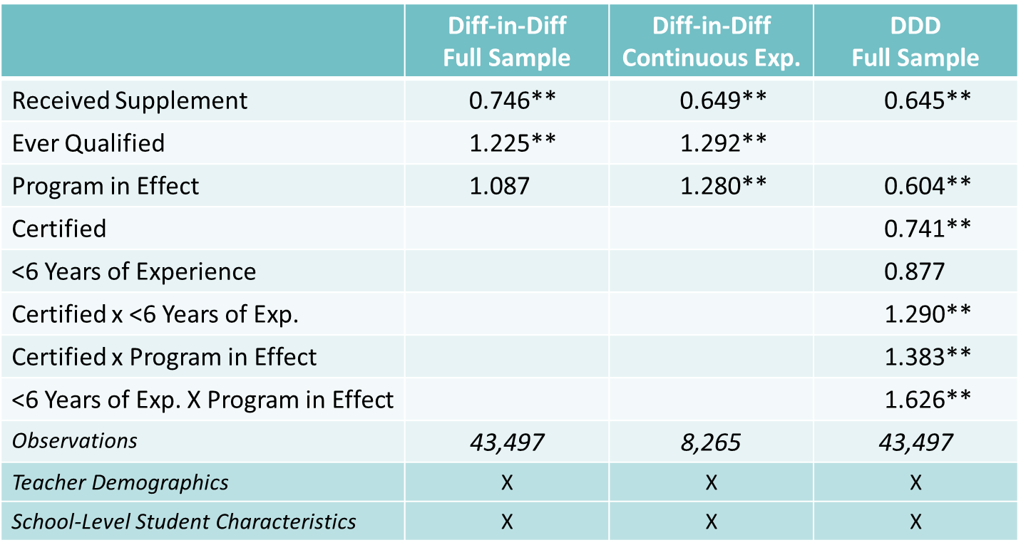
Diff. in Diff. Estimates of Exit Hazard Ratios
(Ever 6-12 Math/Science Teachers Observed in First Year of Teaching)

Slide 22
To-Do List
Retention Analysis
  Include Size of Supplements in Analysis
  Investigate cases where qualifications do not align with treatment status
    If implementation problems are effectively random, could compare eligible and treated with eligible and not treated
Estimate Effects of Differential Pay on supply of new teachers and teacher quality

