Slide 1
Has It Always Been This Way? Tracing the Evolution of Teacher Quality Gaps in U.S. Public Schools
Dan Goldhaber^{1,2}, Vanessa Quince², and Roddy Theobald¹
¹CALDER, American Institutes for Research
²Center for Education Data & Research, University of Washington
This work is supported by the William T. Grant Foundation (grant #184925) and the National Center for the Analysis of Longitudinal Data in Education Research (CALDER) (grant #R305C120008)

Slide 2
Context
Significant evidence of “teacher quality gaps” (TQGs) between advantaged and disadvantaged students in U.S. public schools in terms of teacher credentials (e.g. Clotfelter et al., 2005; Kalogrides and Loeb, 2013; Lankford et al., 2002)
Mixed characterizations of evidence of TQGs in terms of value added (e.g., Goldhaber et al., 2015; Isenberg et al., 2013, 2016; Mansfield, 2015; Sass et al., 2010; Steele et al., 2015)
Limited evidence about the sources of these gaps, their prevalence across different contexts, and their persistence over time
This is important because we care about equity, but also because if TQGs are really persistent it probably means that they’re harder to close
Federal government recently directed states to develop plans to reduce inequity in the distribution of teacher quality across public schools

Slide 3
Data and Analytic Approach
Focal states
North Carolina (teacher-level and student-level data since 1995)
Washington (teacher-level data since 1988; student-level data since 2006)
Measures of teacher quality
Experience, licensure test scores, and value added
Measures of student disadvantage
URM (Black, Hispanic, or American Indian) and FRL (receipt of free/reduced priced lunch)
Analytic Approach
For each combination of teacher quality measure and student disadvantage measure, calculate the TQG as the average difference between disadvantaged and advantaged students in their exposure rates to low-quality teachers
Track the evolution of these gaps in each state
Investigate the extent to which each gap is due to differences across districts, across schools within a district, and (for years and grades in which student-teacher links are available) across classrooms within a school

Slide 4
Assessing Sources of TQGs
Overall TQG: Difference in probability that disadvantaged and advantaged students are assigned to low-quality teachers
Overall TQG can be decomposed into three parts:
Portion due to sorting across districts
Portion due to sorting across schools within the same district
Portion due to sorting across classrooms within the same school
Gaps due to within-school sorting are generally small: presentation focuses on district-level and school-level TQGs (available for longer panel)
Sources of TQGs matter for policy purposes
Interventions to address cross-district sorting very different than interventions to address within-district, cross-school sorting

Slide 5
Measures of Teacher Quality
Teacher experience
Focus on distribution of novice teachers (< 5 years experience)
Also test <2 years experience as robustness check
Licensure test scores
Focus on distribution of teachers in lowest quartile of distribution
Also test lowest decile as robustness check
Value added
Focus on distribution of teachers in lowest quartile of distribution
Also test lowest decile as robustness check

Slide 6
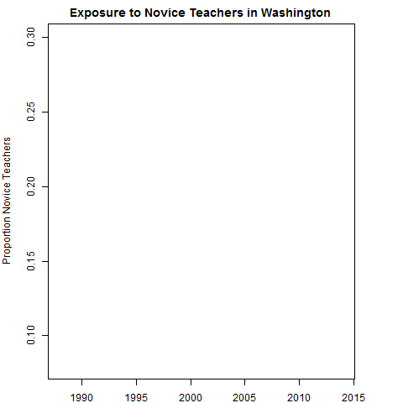
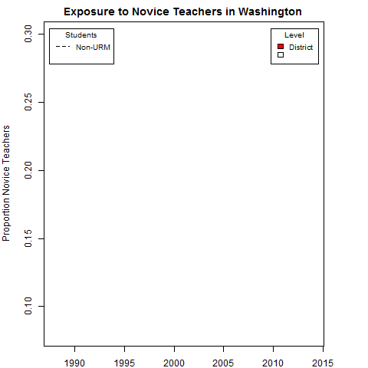
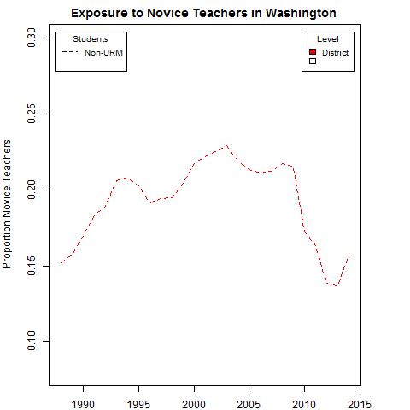
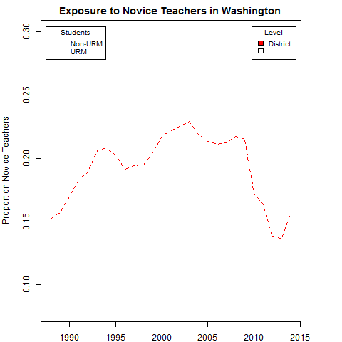
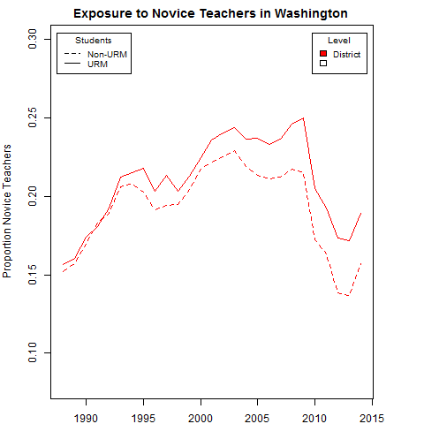
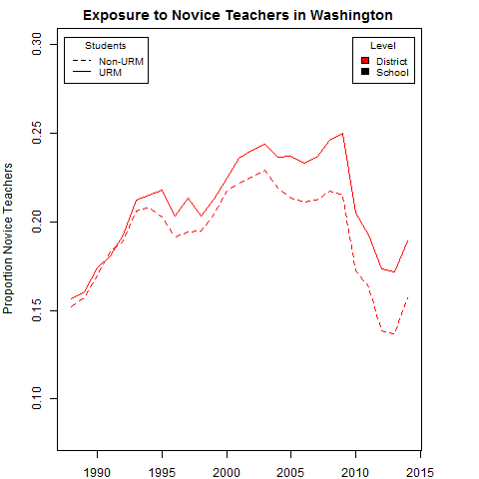
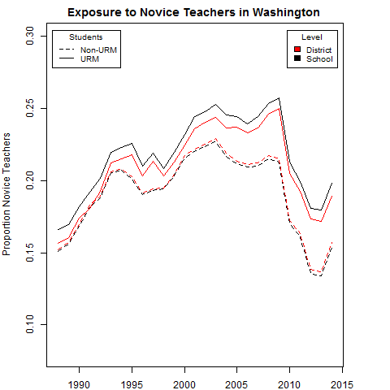
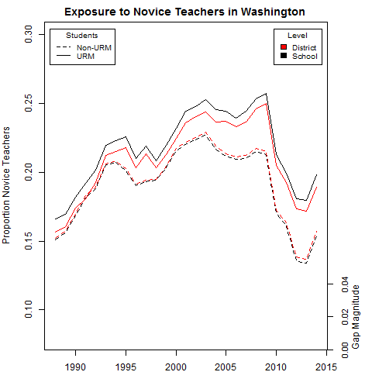
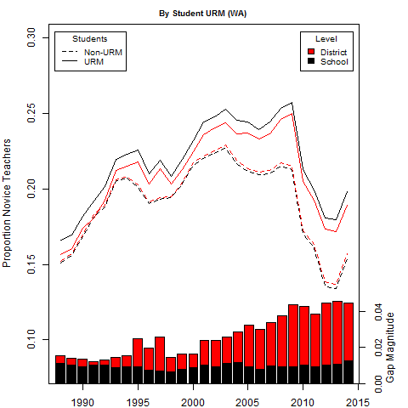
Average proportion of novice teachers in schools attended by URM students
Average proportion of novice teachers in districts attended by URM students
Motivating Example
What is the history of TQGs between URM and non-URM students in Washington with respect to exposure to novice (<5 years) teachers across all grades?
Portion of gap explained by cross-school, within-district sorting
School-level TQG
Portion of gap explained by cross-district sorting
District-level TQG
Average proportion of novice teachers in districts attended by non-URM students
Average proportion of novice teachers in schools attended by non-URM students
Overall gap represents 25% increase in probability of receiving novice teacher

Slide 7
North Carolina
Washington
Figure from previous slide
Student URM
Proportion novice teachers across all grades by
Student FRL

Slide 8
Measures of Teacher Quality
Teacher experience
Focus on distribution of novice teachers (< 5 years experience)
Also test <2 years experience as robustness check
Licensure test scores
Focus on distribution of teachers in lowest quartile of distribution
Also test lowest decile as robustness check
Value added
Focus on distribution of teachers in lowest quartile of distribution
Also test lowest decile as robustness check

Slide 9
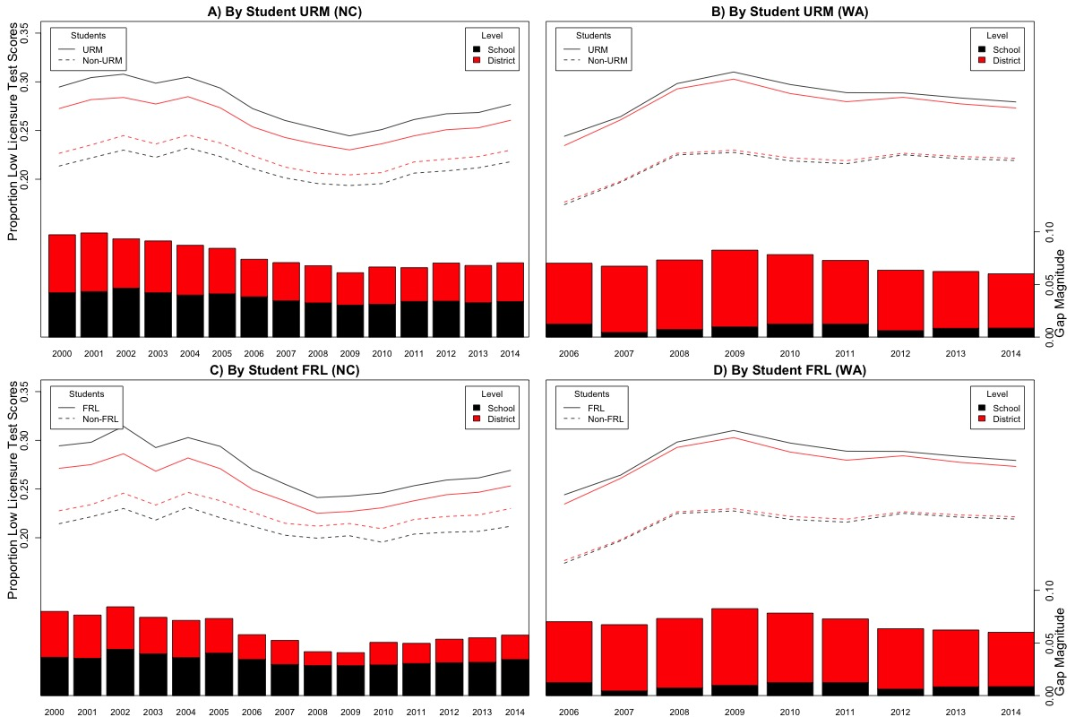
North Carolina
Washington
Student URM
Disadvantaged students (URM or FRL) consistently 20%-40% more likely to have teacher in bottom quartile of distribution of licensure test scores
Proportion bottom quartile licensure test teachers across all grades by
Student FRL

Slide 10
Measures of Teacher Quality
Teacher experience
Focus on distribution of novice teachers (< 5 years experience)
Also test <2 years experience as robustness check
Licensure test scores
Focus on distribution of teachers in lowest quartile of distribution
Also test lowest decile as robustness check
Value added
Focus on distribution of teachers in lowest quartile of distribution
Also test lowest decile as robustness check

Slide 11
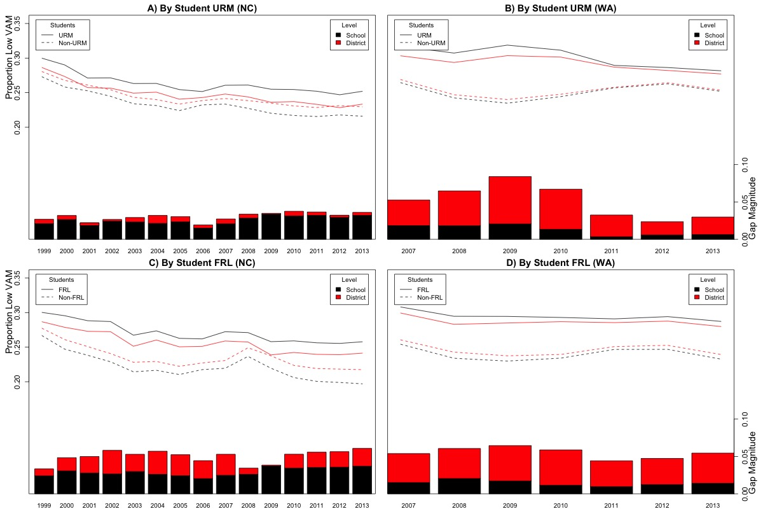
North Carolina
Washington
When comparisons are made with average value added, TQG is consistently between .02 and .04 standard deviations of student performance
Student URM
Proportion bottom quartile value added teachers across all grades by
Student FRL

Slide 12
Reconciling TQGs Based on Value Added
Isenberg et al. (2016): “High- and low-income students have similar chances of being taught by the most effective teachers and the least effective teachers”
Three plausible explanations (among others) are that Isenberg et al. (2016):
Control for peer effects in VAM
Disproportionately consider middle schools
Calculate TQGs only within districts
We use data in Washington to test these different explanations
Goldhaber, D., Quince, V., & Theobald, R. (2016). Reconciling different estimates of teacher quality gaps based on value added. CALDER Policy Brief 14.
Short answer: It’s a little of all three explanations
TQGs in middle school are smaller when VAMs control for peer effects
In Washington, TQGs in all grade levels across districts are larger than TQGs within districts

Slide 13
Supplemental Findings
Dosage of low-quality teachers
Disadvantaged students about 1.5-2 times as likely to have three or more low-quality teachers during elementary school than advantaged students
How much does this matter?
Differences between URM and non-URM students in terms of 4th-8th grade teacher value added appear to explain a non-trivial proportion of the achievement gap between URM and non-URM students in 8th grade in Washington
Heterogeneity of TQGs across districts
There is considerable variation in the magnitudes of TQGs in different districts
Correlations between TQGs and demographics are relatively weak
i.e., the overall diversity of a district is not highly predictive of the extent of inequitable sorting within the district

Slide 14
Summary
TQGs are not a new problem
Disadvantaged students in both states were more likely to be exposed to low-quality teachers in every single year of available data and under every definition of student disadvantage and teacher quality
TQGs by student race have been growing in both states, and are generally (but not always) larger than TQGs by student FRL status
Contrasts with recent evidence that gaps in student performance by race have been decreasing over the past several decades (e.g., Reardon, 2011)
Some differences in the evolution of TQGs depending on the measure of teacher quality we consider
TQGs by teacher experience have grown over time, TQGs by licensure tests have stayed consistent, and TQGs by value added have varied
Within-district sorting of students and teachers contributes to TQGs far more in North Carolina than in Washington
Suggests that we shouldn’t just blame CBAs (no collective bargaining in North Carolina)

Slide 15
Next Steps
Results point to the importance of understanding the processes that contribute to TQGs in U.S. public schools
Teacher attrition
Teacher mobility
Teacher hiring
Changing student demographics
Next steps: How much do each of these processes contribute to TQGs, and what policies might be most effective to close TQGs?

Slide 16
Backup slides

Slide 17
Changing Student Demographics
North Carolina
Washington
Student URM
Student FRL

Slide 18
Geography of Student Demographics
North Carolina
Washington
Student URM
Student FRL

Slide 19
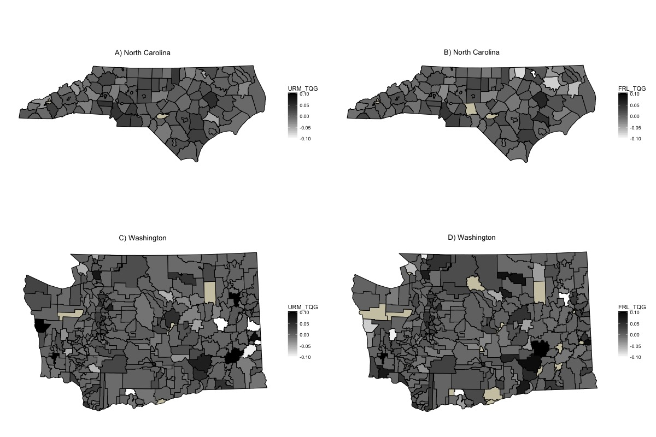
Geography of Novice Teacher TQGs

Slide 20
Table 2. Average Difference in Teacher Value-Added Between FRL and Non-FRL Students in Washington, 2012–13
Panel A: Grades 4–5 Math
Total gap | 0.023 | 0.024 | 0.018 | 0.023 | 0.024 | 0.028 | 0.026 | 0.038
District share | 0.018 | 0.018 | 0.014 | 0.015 | 0.017 | 0.018 | 0.017 | 0.021
School share | 0.002 | 0.002 | 0.001 | 0.003 | 0.004 | 0.005 | 0.006 | 0.010
Classroom share | 0.002 | 0.003 | 0.003 | 0.005 | 0.003 | 0.005 | 0.004 | 0.007
Prior year (vs. current year) |  |  | X | X |  |  | X | X
Peer effects (vs. no peer effects) |  | X |  | X |  | X |  | X
Pooled spec (vs. single year) |  |  |  |  | X | X | X | X
Panel B: Grades 4–5 ELA
Total gap | 0.032 | 0.046 | 0.020 | 0.033 | 0.030 | 0.044 | 0.024 | 0.043
District share | 0.022 | 0.029 | 0.014 | 0.021 | 0.021 | 0.028 | 0.017 | 0.026
School share | 0.009 | 0.013 | 0.005 | 0.010 | 0.008 | 0.013 | 0.006 | 0.013
Classroom share | 0.002 | 0.004 | 0.001 | 0.002 | 0.002 | 0.003 | 0.002 | 0.003
Prior year (vs. current year) |  |  | X | X |  |  | X | X
Peer effects (vs. no peer effects) |  | X |  | X |  | X |  | X
Pooled spec (vs. single year) |  |  |  |  | X | X | X | X
Panel C: Grades 6–8 Math
Total gap | 0.065 | 0.032 | 0.044 | 0.015 | 0.056 | 0.027 | 0.047 | 0.032
District share | 0.029 | 0.012 | 0.012 | -0.003 | 0.026 | 0.010 | 0.020 | 0.012
School share | 0.010 | 0.003 | 0.008 | 0.001 | 0.007 | 0.001 | 0.007 | 0.004
Classroom share | 0.026 | 0.017 | 0.023 | 0.016 | 0.023 | 0.016 | 0.020 | 0.016
Prior year (vs. current year) |  |  | X | X |  |  | X | X
Peer effects (vs. no peer effects) |  | X |  | X |  | X |  | X
Pooled spec (vs. single year) |  |  |  |  | X | X | X | X
Panel D: Grades 6–8 ELA
Total gap | 0.035 | 0.007 | 0.024 | -0.001 | 0.037 | 0.010 | 0.032 | 0.017
District share | 0.016 | 0.000 | 0.009 | -0.006 | 0.016 | 0.000 | 0.013 | 0.004
School share | 0.007 | 0.000 | 0.006 | 0.001 | 0.008 | 0.002 | 0.008 | 0.004
Classroom share | 0.012 | 0.007 | 0.008 | 0.005 | 0.013 | 0.009 | 0.011 | 0.009
Prior year (vs. current year) |  |  | X | X |  |  | X | X
Peer effects (vs. no peer effects) |  | X |  | X |  | X |  | X
Pooled spec (vs. single year) |  |  |  |  | X | X | X | X

