Slide 1
Building Better Bridges to Life After High School: Experimental Evidence on Contemporary Career Academies
Steven W. Hemelt
University of North Carolina at Chapel Hill/CALDER
Matthew A. Lenard
Colleen G. Paeplow
Wake County Public School System
CALDER: February 3, 2017

Slide 2
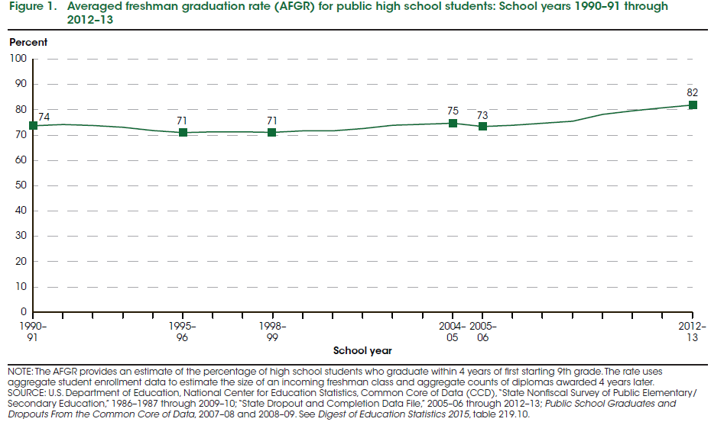
High School Completion
Notes:
Trends in the “status completion rate,” which includes GED-holders as high school graduates look similar (levels are just a bit higher).
Murnane (2015, JEL) shows similar patterns using ACS data (and data from other sources, e.g., Heckman).

Slide 3
High School Completion
About 20% of students fail to finish high school (NCES, 2015)
Dim labor market prospects for those without a HS diploma
Projections forecast continued growth for “middle-skill” jobs that require some form of postsecondary training (Carnevale et al., 2013; Holzer, 2012; 2014)
Causal evidence on interventions capable of boosting HS graduation is “very thin” (Murnane, 2015)

Slide 4
Career Academies
Aim to improve attachment to and performance in high school while exposing students to options for postsecondary study and work
Contemporary career academies place particular emphasis on college-going/continued training part of this goal
Existing work largely reflects older era:
  Before recession
  Before NCLB and its accountability requirements
  Before Common Core and adoption of “college- and career-ready standards” for all students
  Sometimes a holding tank for lower-performing students
Notes:
Career Academies:
Cohort-based, within-school programs
Mix career and technical education (CTE) in a specific area (e.g., health services) with academic coursework
Usually involve some kind of work-based learning, or internship

Slide 5
Career Academies
Little work exploring causal effects of participation in contemporary career academies on educational outcomes.
MDRC: Group of academies that operated during the 1990s
  No effects on high school graduation or college-going (Kemple, 2001)
  Increased labor market earnings for men (Kemple & Willner, 2008)

Slide 6
Our Study
Wake County Public School System (WCPSS)
Administrative data from 2009-10 to 2015-16
Contributions:
Characterize the profile of students enrolling in the district’s extensive system of career academies.
Exploit lottery-based admissions of one, technology-focused career academy to estimate causal effects of attendance on high school and postsecondary outcomes.

Slide 7


Wake County: Career Academies
1st academy = 1990
Slow growth in 1990s and 2000s
Rapid, recent growth since 2000
Today =
20 academies
AOIT
Notes:
Most common areas of academy specialization?
Health sciences (x3)
Information technology, energy, engineering, and digital media (x2 each)
AOIT = Apex Academy of Information Technology; Apex High School

Slide 8
Profile of Academy Enrollees
 | All Students |  |  | Technology Academies
Variable | 9th Graders in Wake County | 9th Grade CA Enrollees |  | Non-CA 9th Graders in Same HS | 9th Grade CA Enrollees
Female | 0.50 | 0.45 |  | 0.49 | 0.41
Black, non-Hispanic | 0.25 | 0.20 |  | 0.29 | 0.13
Hispanic | 0.15 | 0.09 |  | 0.16 | 0.05
White, non-Hispanic | 0.48 | 0.57 |  | 0.45 | 0.71
Asian, non-Hispanic | 0.07 | 0.10 |  | 0.07 | 0.07
8th Grade Math Score (std) | 0.009 (0.999) | 0.427 (0.931) |  | 0.005 (1.046) | 0.517 (0.889)
8th Grade Reading Score (std) | 0.002 (0.999) | 0.316 (0.870) |  | -0.015 (1.070) | 0.360 (0.873)
Academically Gifted (M or R) | 0.28 | 0.43 |  | 0.31 | 0.46
N(students) | 20,968 | 993 |  | 5,524 | 309
Notes: Analytic sample includes first-time 9th graders in WCPSS in 2014-15 and 2015-16. Standard deviations of continuous variables appear in parentheses.
Notes:
Technology academies = 7
Science academies = 4
Engineering academies = 4
“Other” academies (largely non-STEM) = 6 → 5/6, or 83%, are non-STEM

Slide 9
Academy Enrollment Predictors
Outcome = Enroll in CA in 9th Grade
Notes: Analytic sample includes first-time 8th graders in WCPSS in 2013-14 and 2014-15. Model includes middle school fixed effects and indicators for 8th grade cohort.

Slide 10
Apex Academy of Information Technology (AOIT)
Oversubscribed!
  Lots of interest, limited capacity…
Use lottery to fairly select incoming cohorts
Approximates randomized experiment
Allows us to estimate causal effects:
  Lottery winners and losers should be the same in all ways except one: opportunity to attend AOIT
Data:
4 cohorts of 9th grade applicants to AOIT:
2009-2010 to 2012-2013 (N = 469 students)
WCPSS administrative data
National Student Clearinghouse (NSC) data
Notes:
Only 8th graders zoned for Apex High School can apply to AOIT.
AOIT only admits students in the 9th grade; views academy as cohort-based commitment.
Apex High School houses no other academies (during our period of study).
WCPSS administrative data: demographics, prior achievement, HS course-taking, HS performance, HS graduation.
CANNOT use FARM data due to Wake County’s interpretation of Department of Agriculture’s regulations regarding this variable’s use in research.
Postsecondary data: National Student Clearinghouse (NSC)

Slide 11
As good as random?
Notes:
Full set of covariates on which we test balance: gender, race and ethnicity, LEP status, special education status, baseline (8th grade) math and reading test scores, indicator for academically gifted.
We are unable to reject the null hypothesis that the means of these baseline characteristics are the same for lottery winners and losers (p-value of joint test = 0.76).

Slide 12
AOIT: Treatment-Control Contrast
Dimension | AOIT Enrollees (“Treatment”) | Apex HS Non-AOIT Enrollees (“Control”)
Work-based Learning; Workplace Engagement | Paid internship in 11th grade; Job shadowing and career-development day-trips | Not available to non-AOIT students
Non-Academic Supports | Networking through local Chamber of Commerce, resume preparation, mock interviews, job shadowing, and pre-internship training | Not available to non-AOIT students
Curriculum | Cohort-based progression; project-based learning; teachers of CTE and academic courses collaborate during common, weekly planning time | No cohort-based structure to curriculum
IT Courses (required electives) | Sequence of courses that reflects one of two themes: programming or multimedia/web design (= 1/3 of content) | Limited availability to non-AOIT students (5% to 10% of course enrollees drawn from wider high school)
Bridge to Postsecondary Study | Students take college-level IT course (either AP or articulated) during 12th grade | No special encouragement or 12th grade course requirements
Notes:
Control condition/counterfactual is exceptionally clear: Share of lottery losers that enters “regular” Apex High School track is 96% (an average across cohorts in analytic sample)

Slide 13
High School Graduation
**
**
**
Notes: *** p<0.01, ** p<0.05, * p<0.1.
Notes:
Also some suggestive evidence that bulk of effect is coming from middle/upper-middle part of baseline achievement distribution (i.e., 8th grade test scores).
Control means:
All students = 0.90
Male = 0.89
Female = 0.93

Slide 14
Student Engagement: 9th Grade Absences
 | All Students
 | Number of days absent, 9th Grade | Share of days absent, 9th Grade | Absence rate >= 50th pctile | Absence rate >= 95th pctile
Independent variable | (1) | (2) | (3) | (4)
A. Effect of Winning Lottery (ITT)
Won lottery | -1.194** | -0.007** | -0.047 | -0.037*
 | (0.579) | (0.003) | (0.046) | (0.020)
B. Effect of Enrolling in Career Academy (TOT)
Enrolled in AOIT | -1.430** | -0.008** | -0.056 | -0.044*
 | (0.630) | (0.003) | (0.055) | (0.026)
Outcome mean, control group | 3.78 | 0.02 | 0.61 | 0.07
N(students) | 469 | 469 | 469 | 469

Slide 15
Achievement & Advanced Course-taking
No effects of academy enrollment on…
  ACT Composite score, ACT Math score, or ACT Reading score
  Likelihood of taking an AP course (any), an AP Math/Science course
  Sitting for an AP exam
  Success on AP exam (= scoring 3 or higher)
Punchline: Academy enrollees perform as well as their non-academy counterparts.

Slide 16
Unpacking the HS Graduation Effect
 | Outcome = High school graduation (on-time, expected)
 |  | Include controls for potential mechanisms
 | Preferred specification (Table 5, col 3) | 9th Grade Attendance | Advanced HS Course-taking | HS Test Scores
Independent variable | (1) | (2) | (3) | (4)
A. Effect of Enrolling in Career Academy (TOT)
Enrolled in AOIT | 0.078*** | 0.063** | 0.063** | 0.062**
 | (0.029) | (0.029) | (0.027) | (0.027)
Reduction in impact of CA enrollment:
% explained by 9th grade absences |  | 19
% explained by 9th grade absences, advanced HS course-taking |  |  | 19
% explained by 9th grade absences, advanced HS course-taking, HS test scores |  |  |  | 21
N(students) | 469 | 469 | 469 | 469

Slide 17
College Enrollment
*
*
Notes: *** p<0.01, ** p<0.05, * p<0.1.
Notes:
Outcome captures enrollment in college within 1 year of on-time, expected HS graduation.
Control Means:
All = 0.80
Males = 0.78
Females = 0.85

Slide 18
Conclusions and Caveats
Enrollees in modern-day career academies across Wake County are higher performing than their non-academy peers.
  Female, Hispanic, and LEP students are less likely to enroll in an academy than others.
Participation in technology-based academy increases high school graduation and college-going, with attainment gains concentrated among males.
Improved attendance in 9th grade accounts for roughly 1/5th of HS graduation effect.
One academy in lottery-based analysis → limited external validity
  Paints paths for future research
  Existence proof for the potential of high-quality academies to influence high school completion and college-going

Slide 19
Next Steps
Integrate additional academies as they adopt lottery-based admissions
Labor market data?!?
  Fingers crossed
  Does academy participation affect the likelihood that a student works while enrolled in college?

