Slide 1
How High Schools Explain Students’ Initial Colleges and Majors
Rajeev Darolia
University of Missouri
Cory Koedel
University of Missouri

Slide 2
Motivation and Contributions
Research and policy discussions on student sorting in postsecondary education typically use subjective and fairly broad-brush categorizations of majors – namely STEM and non-STEM.
However, empirically there is substantial variability in the selectivity of majors within STEM and non-STEM disciplines, and overlap between STEM and non-STEM fields.
One objective of our study is to construct new measures of university quality, and major quality, that are flexible and empirically grounded and can be used to examine postsecondary sorting.
We use our measures to examine sorting to universities and majors in the 4-year public university system in Missouri and specifically, the role of high schools in predicting the quality of student placements.

Slide 3
Preview of Findings
We construct empirical measures of quality for each university-by-major cell in the Missouri 4-year higher education system.
We document empirical facts about initial sorting in the Missouri system:
64 percent of the variance in entering cell quality occurs across universities (a substantial amount!); 36 percent occurs between majors within universities (also substantial!).
Students are widely dispersed across universities and to majors within universities.
This raises questions about the importance and malleability of sorting within universities.
We then go onto examine the predictive influence of high schools over student placements.
Consistent with other recent research, we find that high schools explain a substantial fraction of the variation in the quality of student placements to universities conditional on their own academic preparation.
Students from lower-SES high schools systematically enroll in lower-quality universities.
However, we find no evidence that students from lower-SES high schools systematically enroll in lower-quality majors within universities.

Slide 4
Context and Data
13 Four-Year Public Universities
Most Selective: (1) Truman State University, (2) UM-Rolla (Missouri University of S&T), (3) UM-Columbia (State Flagship)
Urban Campuses: (1) UM-Kansas City; (2) UM-St Louis
Moderately Selective (Destination Campuses): (1) Missouri State University, (2) Northwest Missouri State University, (3) Southeast Missouri State University, (4) University of Central Missouri
Least Selective: (1) Missouri Southern State University, (2) Missouri Western State University, (3) Lincoln University (HBU), (4) Harris Stowe State University (HBU)

Slide 5
Context and Data

Slide 6
Context and Data
Administrative micro data from Missouri Department of Higher Education.
We focus on non-transfer, full-time, Missouri-resident college entrants who enter into one of the thirteen 4-year public universities from a public high school.
Cohorts entering between 1996 and 2001 (6 entering cohorts). The final analytic sample includes 58,377 students.
Majors upon entry and exit are identified using the Classification of Instructional Programs (CIP) taxonomy developed by the US Department of Education (4 digit; e.g., general biology, sociology, economics).
We treat two cells with the same CIP code at different universities as different entering cells in the system.
In total, students in our sample entered into 476 university-by-major cells across the 13 universities, from 455 high schools.

Slide 7
University-by-Major Quality: Measurement and Variability
We measure university-by-major cell quality throughout the system by the pre-college-entry academic preparation of students who graduate in each cell.
Our pre-entry preparation metrics are ACT math and reading scores and high school class rank.
We combine these metrics into a single “preparation index” for each student, which is a weighted average where the weights are determined by how important each metric is for predicting college-degree completion (within cells).
The cell quality measures are essentially averages of the individual-student preparation indices among degree completers (with a statistical adjustment).
Differences across cells derive from differences in initial student selection, survival, and cross-cell student transfers.
Technical details are provided in the paper.

Slide 8
University-by-Major Quality: Measurement and Variability
The procedure from the previous slide generates flexible, empirically-derived measures of academic quality for all of the university-by-major cells in the system.
Cell rankings are not overly constrained by university selectivity; e.g., some majors at a less selective university can be of higher quality than some majors at a more selective university.
Rankings are unconstrained by subjective categorizations of majors; e.g., STEM versus non-STEM
Related to the previous point, our measures capture heterogeneity within STEM and non-STEM fields.
A basic variance decomposition indicates:
64 percent of the variance in cell quality occurs across universities.
36 percent occurs within universities.

Slide 9
The Explanatory Power of High Schools Over Placement Quality
We apply our measures to examine the role of high schools in explaining student sorting to initial colleges and majors in the Missouri system.
In all of our models, we evaluate the predictive role of high schools conditional on students’ own academic preparation.
In words, we predict the quality of the entering cell (college j, major m), for each student i who attended high-school s. The AI-term in the regression captures the student’s own academic preparation.
The quality measures on the left-hand side in the above equation capture overall cell quality. We also estimate analogous models where the dependent variable is modified to net out university quality – that is, where we examine the predictive power of high schools over sorting to majors within universities.

Slide 10
The Explanatory Power of High Schools Over Placement Quality
Summary of findings on high schools.
High schools explain a substantial faction of the variance in the quality of student placements system-wide.
11.3 percent
High schools explain very little of the variance in the quality of student placements within universities.
1.4 percent
We then go on to look for evidence of systematic differences in placement quality between students from low- and high-SES high schools.
Complementing previous research on student undermatch to universities, we find that students from lower-SES high schools systematically enroll in lower-quality universities conditional on their own preparation.
There is no evidence of a systematic relationship between high-school SES and student placements to majors within colleges.

Slide 11
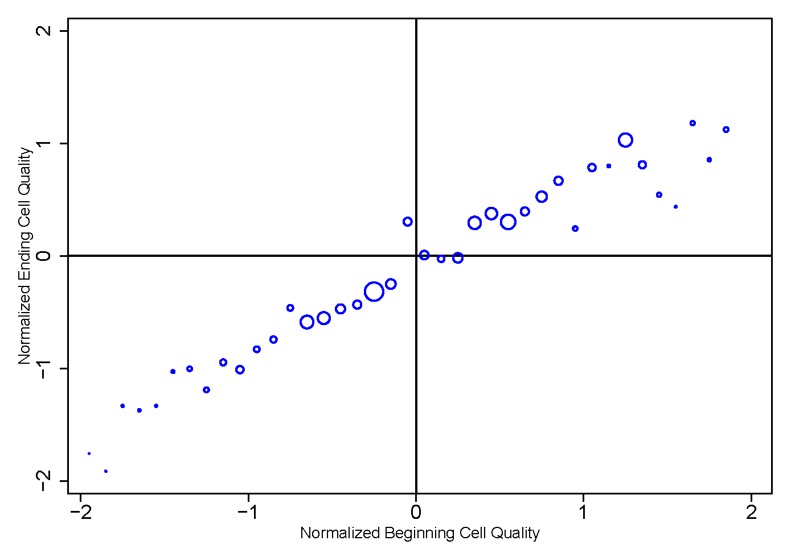
Mapping Initial to Final Cell Quality (Degree Completers)

Slide 12
Concluding Remarks
We develop new, empirically-grounded measures of university and major quality that can help to improve our understanding of student sorting in postsecondary education.
Our measures are flexible and objective, and reveal substantial variation in the quality of university-by-major cells both across and within universities.
Our finding that students from lower-SES high schools systematically enroll in lower quality universities corroborates previous, related evidence.
Simple, low-cost information interventions may help to remedy this problem.
A similar pattern is not observed for sorting to majors within universities.
Our analysis also prompts the question of if and how within-university variability in major quality affects student outcomes.
Evidence on college quality suggests that more-selective institutions causally improve student outcomes – could this also be the case for majors within universities?
Answer depends on mechanisms: access to peers, faculty, expectations, resources.
Are within-university cell placements malleable? Should universities be doing more to help students navigate college (e.g., by providing better information about program variability and student fit)?

